Slide 1
Hibernate Introduction
ORM - Object –Relational Mapping
Hibernate is the BEST ORM framework available with Java.
Data fetch 2. Save Data 3. Modify Data
To do all these data activities through application like Java, C#, Pyhton we need Connectors. For Java it is JDBC. Applications talk to databases as objects/classes. Whereas Databases have entities like Tables.
From Object world of Applications one fires SQL queries to access data from the tables rows and columns.
So, when there are lots of Databases with their individual SQL syntaxes is difficult to port from Applications, Hibernate helps to eliminate that hurdle
Pre-requisites for Hibernate
Core Java knowledge 2. SQL & Relational Database concepts 3. JDBC knowledge

Slide 2
Hibernate
Application (Java, C#, Python)
Persistence (RDBMS Database)
(Variable, Objects) Variable is transient type of data
MySQL, Oracle, SQL Server (Postgress) NoSQL (Mongo DB)
Class Student
{
int rollno;
String name;
int marks;
}
Temporary (transient)
data
JDBC
For use of JDBC we need to be knowing a good amount of SQL,
Which is not preferred by many developers
Obj1
Hibernate
s.save (obj);
Database
s.get (obj);
persistence
(101, “Debasis”, 89)
s.update (obj);
XML /
Java Configuration
Student Table
s.delete (obj);
Session Factory
rollno
name
Obj2
Session (s)
marks
O
R
M
(102, “Mousumi”, 92)
Obj3
(103, “Sadeeq”, 95)
So, there are 3 objects which represents the 3 rows of the table, the table in turn is nothing but the Class of the application
Object (Class) Relational (Database) Mapping (Mechanism)
Hibernate, iBatis, Oracle’s TopLink are the ORM tools

Slide 3
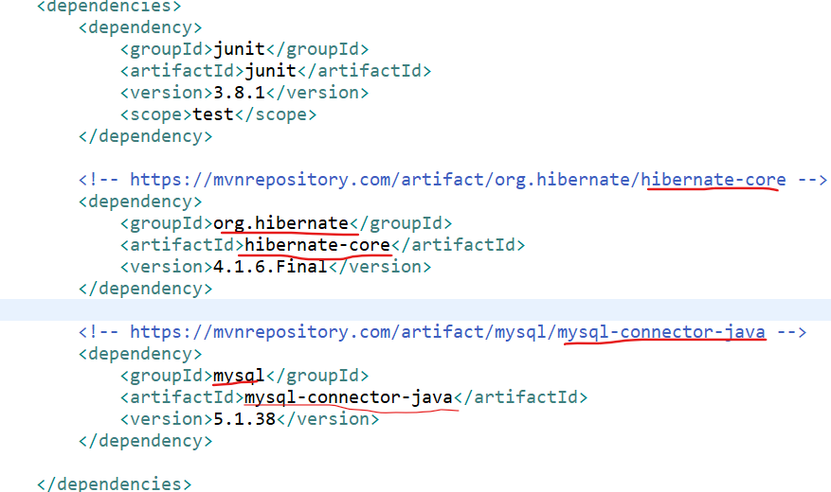
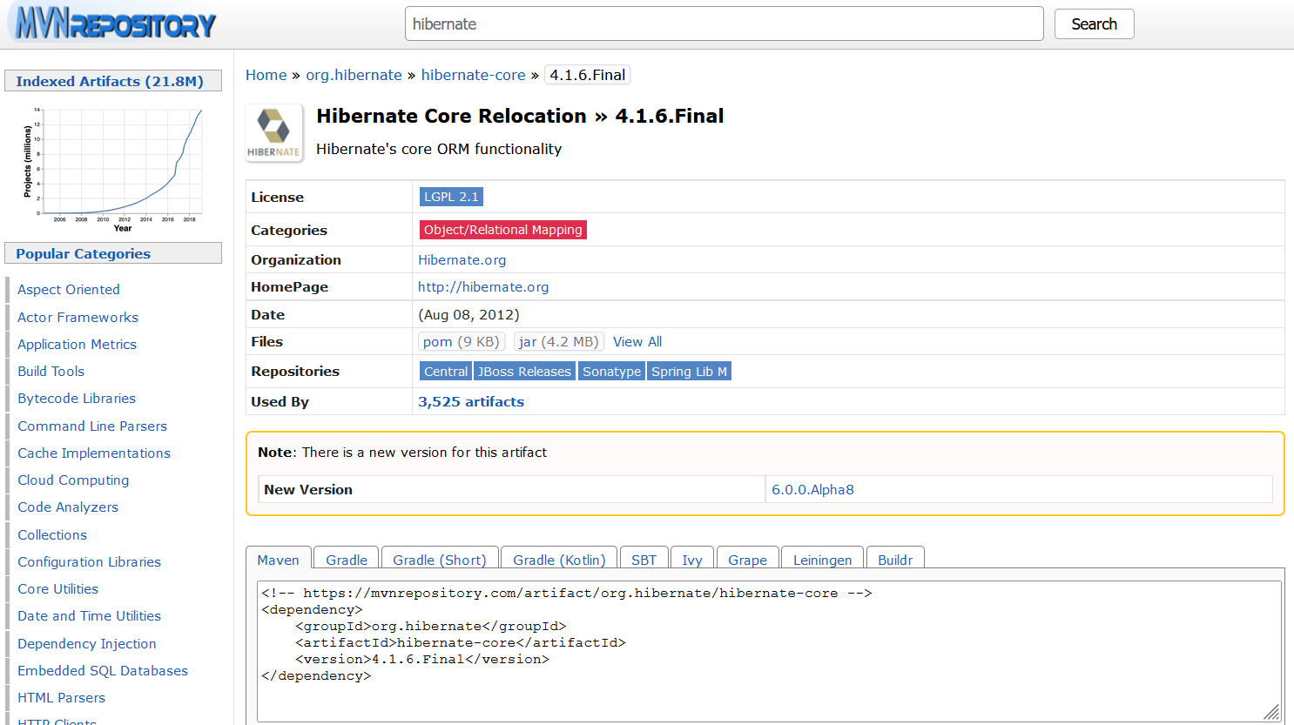
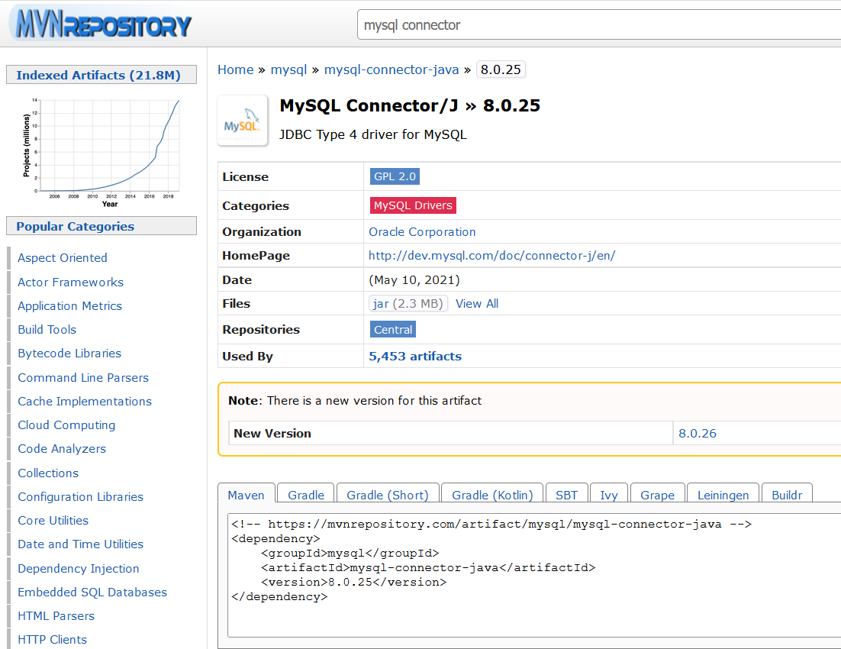
Hibernate Library & MySQL library configuration
POM.XML
8.0.25

Slide 4
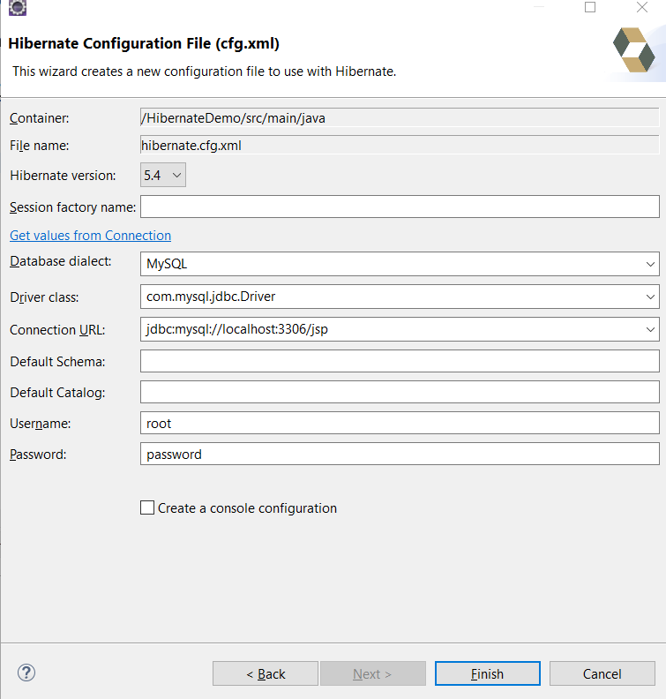
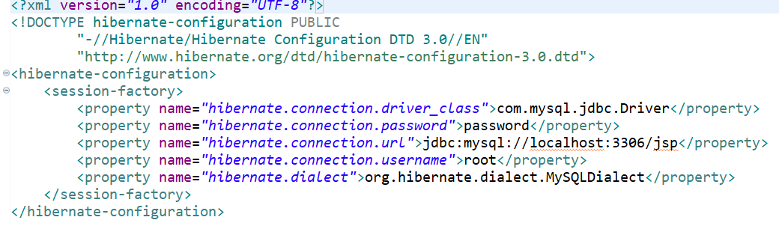
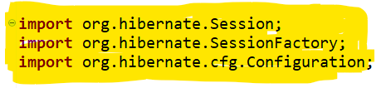
Hibernate Plugin & Configuration File
How to add Hibernate Plugin in Eclipse
Help -> Eclipse MarketPlace -> search for Hibernate -> Jboss Tools -> Install -> select features -> Review Licenses -> Finish
Configuration File
Right Click on project -> New -> Other -> Select a Wizard -> search for Hibernate -> Select Hibernate cfg file -> Configuration file

Slide 5
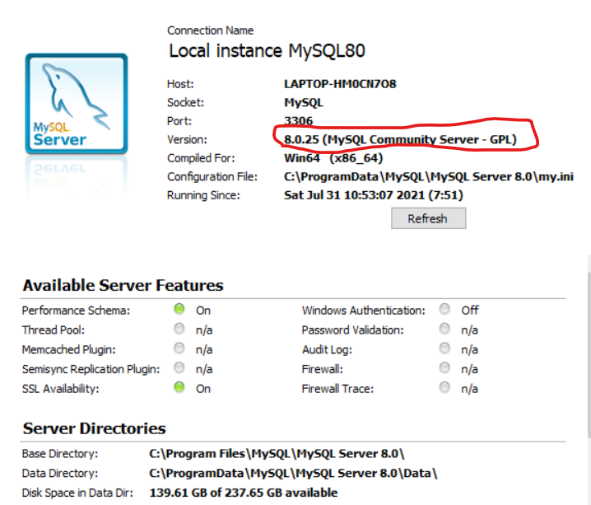
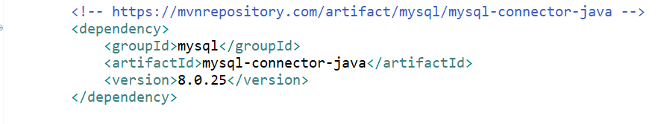
Hibernate DB connection Error…
Error:
ERROR org.hibernate.tool.hbm2ddl.SchemaUpdate - HHH000319: Could not get database metadata
com.mysql.jdbc.exceptions.jdbc4.MySQLNonTransientConnectionException:
Could not create connection to database server. Attempted reconnect 3 times. Giving up.
Solution:
MySQL installation version should match with MVNrepository:
Mysql-connector-java library version

Slide 6

Hibernate Relations
Hibernate establishes
laptop
student
@Entity
public class Laptop
{ @Id
private int lid;
private String lname;
@ManyToOne
private Student stud;
getters();
setters();
}
rollno
lid
lname
rollno
name
marks
lid
@Entity
public class Student
{ @Id
private int rollno;
private String name;
private int marks;
@OneToOne
private Laptop laptop;
@OneToMany(mappedBy “stud”)
private List<Laptop> laptops
getters();
setters();
}
Many to Many
One to Many
One to One
1
101
Lenovo
1
Debasis
89
1
101
1
102
Dell
Sunita
90
1
2
103
2
2
103
MacBook
For one student having multiple laptops,
We need to change OneToOne to OneToMany
student_laptop
lid
rollno
101
1
102
1
103
2
Mapping table

Slide 7
Hibernate Caching
Hibernate advantages over JDBC
ORM -> Relational mapping with Databases establishing OneToOne, OneToMany, ManyToOne, ManyToMany relations
at ease without having a Java Developer waste a considerable time in learning complicated SQL queries
Caching -> Hibernate implements a unique mechanism of Caching which reduces database hits and enables sessions to
share a cache of results for similar queries
Application Server
Database
Vendors for Cache:
ehCache
OSCache
Swarm
First Level Cache by default
Session 1
Request
Select * from student
Client
Pom.xml
(To include
Ehcache dependency)
Hibernate.cfg.xml
(provide <property>
Permissions
Vendor like ehcache)
Session 2
First Level Cache by default
Session 3
Session 6
Multiple rows maybe in 1000s
Session 5
Entity Annotations
Cachable
Cache
Session 4
Second Level of Cache (configurable)
Hibernate takes a third party vendor eCache library to integrate Cache feature
Ehcache Library from Mvnrepo
(Cache features)
Hibernate-Ehcache jar from Mvnrepo
(Integration features)

Slide 8
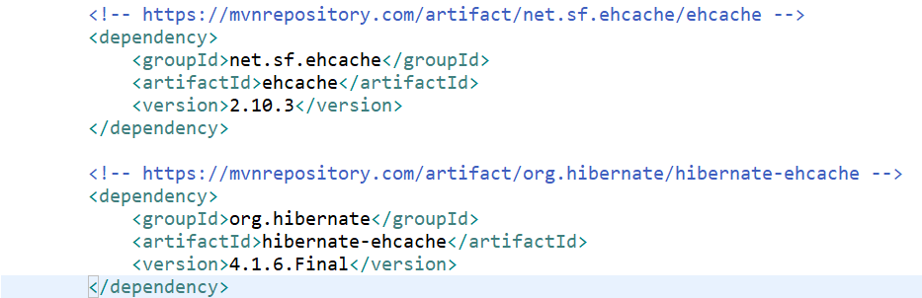
Hibernate EHCache Configuration (Second Level Caching)
How to add EHCache in POM.XML
MVNrepository -> search “ehcache” -> select 2. Ehcache (net.sf.ehcache) -> Select version 2.10.3 -> copy Maven dependency -> paste in pom.xml under dependencies -> save file -> check the snapshot
How to add Hibernate-Ehcache in POM.XML
MVNrepository -> search “hibernate-ehcache” -> select 1. Hibernate Ehcache Relocation >> hibernate-ehcache -> Select version 4.1.6.Final (should be same as Hibernate Core version) -> copy Maven dependency -> paste in pom.xml under dependencies -> save file -> check the snapshot
Hibernate.cfg.xml
Hibernate-ehcache has to be set with 2 properties ->
hibernate.cache.use_second_level_cache 2. hibernate.cache.region.factory_class

Slide 9
Hibernate Query Language (HQL)
SQL
HQL
select rollno from student;
select rollno from Student;
Column
Property
Table
Class
select * from student;
from Student;
SQL can be used in HQL
Called “Native Query”
Join two tables
Join two entity classes
Group by, Order by
Group by, Order by
ResultSet rs = st.executeQuery(sql);
while rs.next() {
}
List<Student> st = Query.list();
for (Student s: st ) {
System.out.println(s);
}

Slide 10
Hibernate Object States – Persistence Life Cycle
Object
garbage
Alien a = new Alien();
a.setId(101);
a.setName(“Debasis”);
a.setTech(“Java”);
Transient
new
garbage
save();
persist();
garbage
Object
get();
find();
Persistent
remove();
Persistent
detach();
Or
evict();
Detached

